Slide 1
Data Collection Tool
The Survey

Slide 2
What is a survey?
An activity in which many people are asked question or a series of questions in order to gather information about what people do or think about something. The group of people from which you gather information is known as sample.

Slide 3
Purpose of running surveys:
1- To uncover the answers
2- Evoke discussions
3- Base decisions on objective information
4- Compare results

Slide 4
1-Uncover Answers
In a non-intimidating survey environment, you will learn about what motivates survey respondents and what is important to them, and gather meaningful opinions, comments, and feedback. Respondents are more likely to provide open and honest feedback in a more private survey method. Methods such as online surveys, paper surveys, or mobile surveys are more private and less intimidating than face-to-face survey interviews or telephone surveys.

Slide 5
2- Evoke Discussions
Give your survey respondents an opportunity to discuss important key topics. Communicate with your respondents about your survey topic. This allows you to dig deeper into your survey, and can incite topics related to your survey within a broader perspective.

Slide 6
3- Base decisions on objective information
Conducting surveys is an unbiased approach to decision-making. Don’t rely on “gut feelings” to make important business decisions. You can collect unbiased survey data and develop sensible decisions based on analyzed results. By analyzing results, you can immediately address topics of importance, rather than waste time and valuable resources on areas of little or no concern.

Slide 7
4- Compare results
Surveys results provide a snapshot of the attitudes and behaviors – including thoughts, opinions, and comments – about your target survey population. This valuable feedback is your baseline to measure and establish a benchmark from which to compare results over time.

Slide 8
Types of Questions
The two common types of questions are:
1- Open ended Questions
2- Close ended questions

Slide 9
1- Open Ended Questions
Open-ended questions require an answer with more depth and a lengthier response. Open-ended questions are ones that require more than one word answers. The answers could come in the form of a list, a few sentences or something longer such as a speech, paragraph or essay. Respondents give their own opinions.
Example: What is the purpose of government?
How do you see your future?

Slide 10
2- Close – Ended Questions
If you can answer a question with only a "yes" or "no" response, then you are answering a closed-ended type of question. The options are provided by the surveyor.
Examples: Were you born somewhere between 2010-2020?
Are you a millennial?

Slide 11
- Demographic Questions
Demographics are characteristics of a population. Characteristics such as race, ethnicity, gender, age, education, profession, occupation, income level, and marital status, are all typical examples of demographics that are used in surveys.
Example:Q. Age: What is your age?
-Under 12 years old
-12-17 years old
Q. Ethnic origin: Please specify your ethnicity.
-White
-Hispanic or Latino

Slide 12
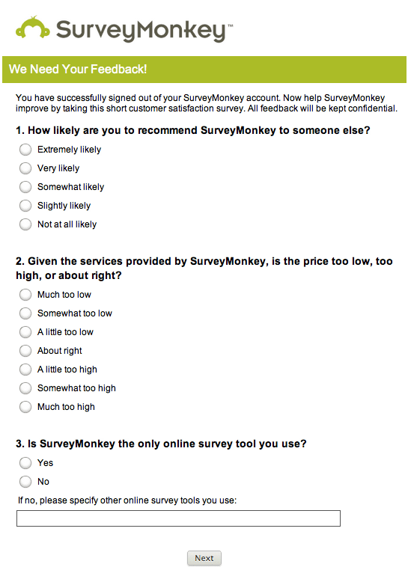
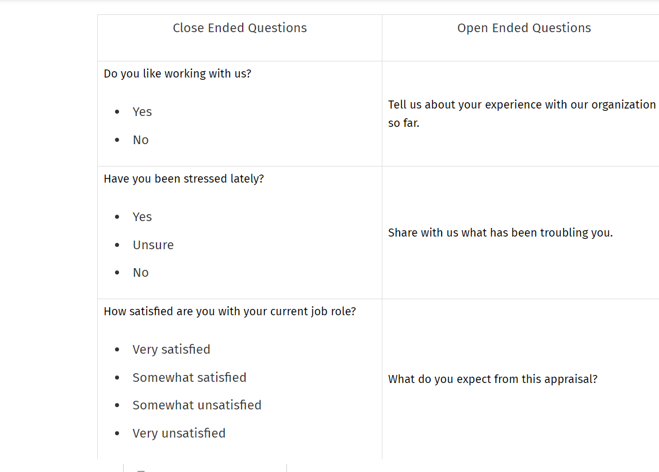
Close ended & Open ended survey questions

